Slide 1

Arrays, Objects, Prototypes
Aris Markogiannakis
City University - Short Courses
CS3606 : JavaScript 2: Advanced Javascript for Websites and Web

Slide 2
This week?
This week we will learn about:
Arrays
Objects
Prototypes

Slide 3
Everything is an object
In JavaScript we have two big types of values primitives and everything else …
Primitives include strings, numbers, boolean, undefined
Everything else can be Arrays, Functions, Dates, Objects .. which are all objects...

Slide 4

Arrays - First
Arrays hold sequences, sets or lists of values
We use arrays to store and manipulate data

Slide 5

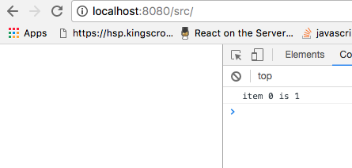
More about Arrays
Arrays have indexes, we can access the elements
How would we get 2, or 3 values?

Slide 6
Array properties
To access properties of the arrays we are using the dot notation.
myArray.name_of_property_or_method

Slide 7
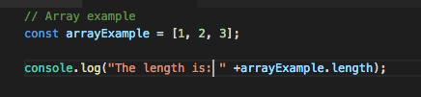
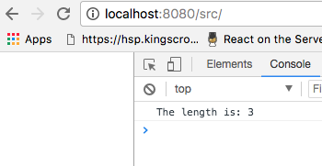
Array Properties
The most used method is Length

Slide 8
Array methods
Push : Add new Items at the end of an array
Pop: Remove the last item of an array
Concat: join two arrays
Slice: Extract part of the array and or copy an array*
Join: Convert an array to a string
forEach: Iterate inside an array passing a callback
Map: creates a new array with the results of calling a provided function on every element in the calling array.
Filter: creates a new array with all elements that pass the test implemented by the provided function.

Slide 9
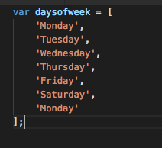
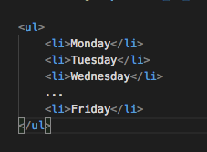
Exercise 1
We have the following array, we want to print it on the page with quotes, we will use the mob-programming way to do this.

Slide 10
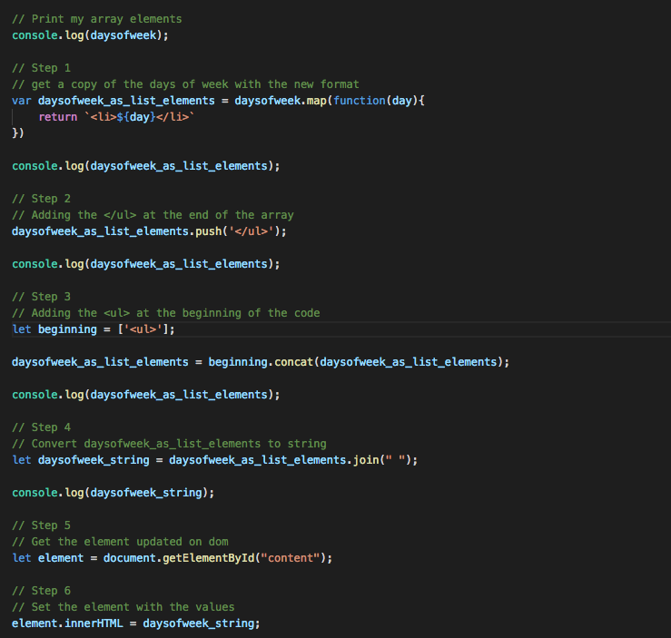
Solution

Slide 11
JavaScript Objects
In other programming languages this is called Class and the object is the instance of the class.
In JavaScript we like to call it a constructor or a prototype
Car
colour
brand
Beeping()

Slide 12
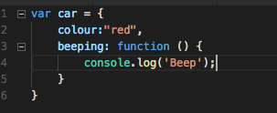
Objects
An object is a blue print of a template that we re-use to store and manipulate complex data
Objects are collections of properties stored as name:value pairs
Values can be anything strings, arrays, objects

Slide 13
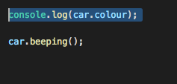
Objects – properties methods
So this is an object called Car.
const myObject = {}; // is empty
Or const myObject = new Object();
Now if we execute this the result
should be?

Slide 14
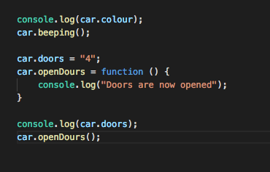

Access properties/methods
We use the ‘dot’ notation to access the Objects properties and methods
We can modify an object for example on this example we created a new property called doors, and a method called openDoors.

Slide 15
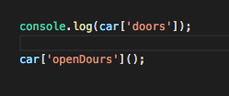
Alternatives for accessing properties
We can also use the bracket notation to access methods and properties

Slide 16
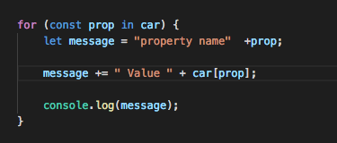
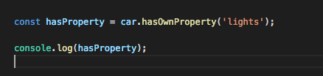
Iteration
We use for..in loop to iterate through an object and get the properties and methods.
We can check if an object has a property using hasOwnProperty method

Slide 17
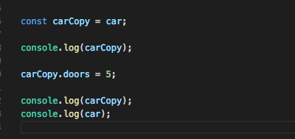
Object: Iteration
You can't copy an object with the following code.
The result:
You can copy a primitive but you cant do the same with an object.

Slide 18
Inheritance
Vehicle
Car
speed
colour
Inherits
YearOfPurchase
brand
CalculateAge()
Beeping()
Notes:
The Car access all the methods and properties of the Vehicle class and this saves us from having to re-write all the same code again and again.

Slide 19
JavaScript Inheritance
Vehicle
Car
JavaScript is a prototype based language
Each and every JavaScript object is using a prototype property
Vehicle has a method called CalculateAge().
Car inherits this method by the prototype property
colour
Prototype
CalculateAge()
brand
Beeping()
Prototype

Slide 20
Complete Inheritance and Prototype chain
Vehicle
Object
Car
colour
Prototype
Prototype
CalculateAge()
hasOwnProperty()
brand
IsPrototypeOf()
null
Beeping()
constructor()
ValueOf()
Prototype

Slide 21
Prototype chain
We use the prototype property to make inheritance possible in JavaScript,
We place properties and methods there that we want other objects to inherit.
When a search is done for a method or a property, we start from the current object and we are going down the chain … thus is called Prototype chain.

Slide 22
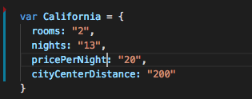
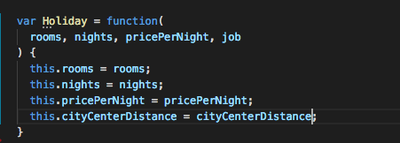

Function constructor
So like we have seen before we can create an object using the function constructor
Imagine the following object California which describes a holiday.
We can use a function to describe a template that we can reuse.
Notes:
https://medium.com/@luke_smaki/javascript-es6-classes-8a34b0a6720a#:~:text=OOP%20in%20JavaScript%20with%20ES6&text=The%20class%20function%20basically%20creates,in%20the%20pre%2DES6%20example.

Slide 23
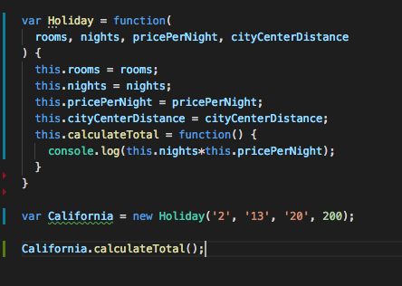
Create private methods
On our previous example we can now add a method called calculateTotal
We can execute it using the dot notation.

Slide 24

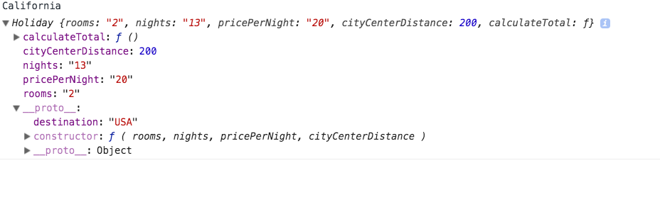
Inheritance
What if we wanted to make a property that all Holiday objects inherit is there a way?
As you can see when we inspect the California object and that destination property we added and set it lives on the prototype property.

Slide 25
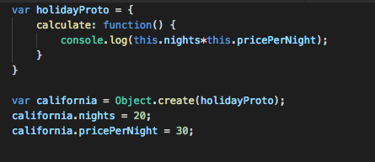
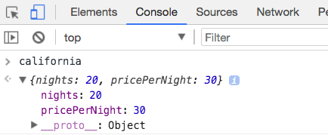
Object.create()
Another way to create an object is to use the Object create
In this case we first create a new object based on the prototype
Then we use the Object.create method to create the object
We can then assign properties to the newly created object.

Slide 26
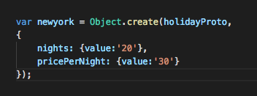
Object.create() improved
The create method takes another argument which is a method inside that method we can initialize all the properties and methods.
The object create is better than function constructor than object.create because you can specify the object prototype.

Slide 27
Exercise 2
Time for our second exercise

